Slide 1
Falls Friday

Slide 2
What is it?
A weekly review of all the falls that occurred the prior week
CNCs and staff involved are scheduled in 10 minute increments to review their falls, discuss suggestions for improvement, ensure documentation correct in chart, audit fall risk scores and interventions

Slide 3
Purpose
Identify trends and opportunities for improvement that can then be disseminated throughout the organization
Allows us to ensure our data is correct for reporting to NDNQI as well as running trend reporting through RL

Slide 4
What have we learned and what have we done
Moderate fall risk patients are falling more than high fall risk patients
Changed the fall prevention guideline to include a recommendation for all moderate AND high fall risk patients
Most of our falls are happening around toileting and urgency
Focus on preventative toileting during purposeful rounding
Education around “okay to stay” encouraging staff to stay with patient for toileting and showering
Education and training for equipment and transfers
New hire orientation to include safe patient handling
Equipment pilot for Sara Steady's on every unit and gait belts in every room
We have seen a 12.3% decrease in preventable falls
January 2023 to June 2023 compared to July 2023 to December 2023

Slide 5
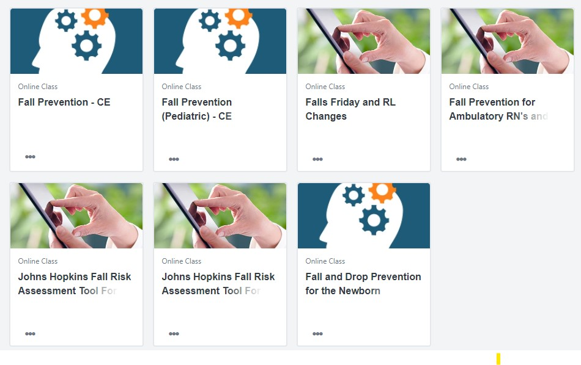
Education

