Slide 1
Medical Care Availability and Reduction of Error (MCARE) Law in Pennsylvania
Presented by:
Michelle Bell, RN, BSN, FISMP, CPPS
Director of Outreach & Education

Slide 2
MCARE Chapter 3
(Act 13 of 2002)

Slide 3
Ancient History: Or is it?
From a Culture of Blame…
Focused on Individual Performance
Focused on Individual Failures:
Surgeon operates on wrong knee
Nurse fails to check ID
Hospital fails to ensure competence

Slide 4
What Did We Learn?
Practice Defensively:
Order more tests
Add words to consent forms
Write complex policies and procedures
Collect data, data and more data
Form committees
Focus on WHO failed

Slide 5
Modern History: The Paradigm Shifts
1999: To Err is Human published
Humans make mistakes
The lens shifts to processes
Processes fail, not people
Emphasis on designing safer processes

Slide 6
Section 303. Establishment of the Patient Safety Authority
Section 304. Powers and Duties
Section 305. Patient Safety Trust Fund

Slide 7
Patient Safety Authority (PSA)
Created under the Medical Care Availability and Reduction of Error Act (MCARE)
Independent State Agency:
Non-punitive, Non-regulatory
11-member Board appointed by the Governor and General Assembly
Dedicated Funding Stream:
Facility assessments
Purpose:
Analyze, Educate, Collaborate

Slide 8
Patient Safety Authority
MISSION:
Improve the quality of healthcare in Pennsylvania by collecting and analyzing patient safety information,
advising facilities through publication, education, collaboration, and issuing recommendations for improvement.
VISION:
Safe healthcare for all patients.

Slide 9
Section 302. Definitions

Slide 10
Event Type Definitions
Incident: An event, occurrence or situation involving the clinical care of a patient in a medical facility which could have injured the patient but did not either cause an unanticipated injury OR require the delivery of additional healthcare services to the patient. The term does not include a serious event.
Serious Event: An event, occurrence or situation involving the clinical care of a patient in a medical facility that results in death OR compromises patient safety AND results in unanticipated injury requiring the delivery of additional healthcare services to the patient. The term does not include an incident.
Infrastructure Failure: An undesirable or unintended event, occurrence or situation involving the infrastructure of a medical facility or the discontinuation or significant disruption of a service which could seriously compromise patient safety.

Slide 11
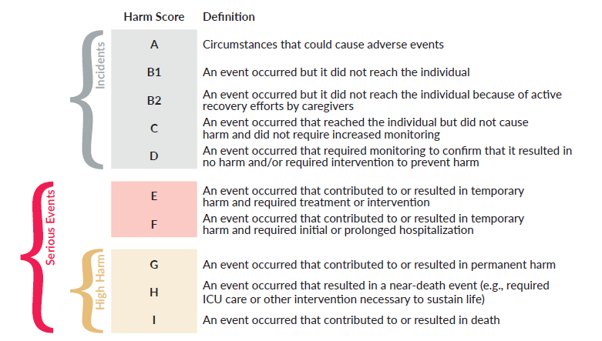

Slide 12
Reporting

Slide 13
Reporting

Slide 14
Patient Safety Authority Learning Model
Patient Safety Professionals
Patient Safety
Event Data
Patient & Family Perspective
Data converted to Actionable Knowledge
Journal
Consultations
Annual Report
Collaboratives
Center of Excellence for Improving Diagnosis
Toolkits
Patient & Provider Education
Safety Alerts

Slide 15
Section 308. Reporting and Notification
Section 304 (b). Anonymous Reports

Slide 16
Healthcare Workers’ Role in Reporting
Section 308. Reporting and notification.
(a) Reporting.--A health care worker who reasonably believes that a serious event or incident has occurred shall report the serious event or incident according to the patient safety plan of the medical facility unless the health care worker knows that a report has already been made. The report shall be made immediately or as soon thereafter as reasonably practicable, but in no event later than 24 hours after the occurrence or discovery of a serious event or incident.

Slide 17
Section 304. Anonymous Reports to the PSA
17

Slide 18
Section 313. Medical Facility Reports and Notification

Slide 19
Serious Event Reporting and Notification
Must be reported within 24 hours of confirmation of the occurrence of the event.
Requires written notification to the patient within 7 days of occurrence or discovery.

Slide 20
Infrastructure Failure Reporting
Must be reported within 24 hours of confirmation of the occurrence or discovery of the event.

Slide 21
Section 313 (e) and (f)
(e) Notification to licensure boards.--If a medical facility discovers that a licensee providing health care services in the medical facility during a serious event failed to report the event in accordance with section 308(a), the medical facility shall notify the licensee's licensing board of the failure to report.
(f) Failure to report or notify.--Failure to report a serious event or an infrastructure failure as required by this section or to develop and comply with the patient safety plan in accordance with section 307 or to notify the patient in accordance with section 308(b) shall be a violation of the Health Care Facilities Act …………a medical facility which fails to report a serious event or an infrastructure failure or to notify a licensure board in accordance with this chapter may be subject to an administrative penalty of $1,000 per day imposed by the department.

Slide 22
Section 307. Patient Safety Plan

Slide 23
Patient Safety Plan
Patient Safety Officer
Patient Safety Committee
Internal Reporting:
24/7 access for healthcare workers
Whistleblower Protections:
Prohibit any retaliatory action against a health care worker for reporting a serious event or incident
Written Notification [for serious events]

Slide 24
Section 309. Patient Safety Officer

Slide 25
Patient Safety Officer
Section 309
Serve on the patient safety committee
Ensure the investigation of all reports of serious events or incidents
Take action as is immediately necessary to ensure patient safety as a result of any investigation
Report to the patient safety committee regarding any action taken to promote patient safety as a result of any investigations

Slide 26
Section 310. Patient Safety Committee

Slide 27
Patient Safety Committee Responsibilities
Receive reports from PSO
Evaluate investigations/actions of PSO
Evaluate quality of facility’s patient safety measures
Make recommendations to eliminate future events
Quarterly report to administrative officer and governing board

Slide 28
MCARE Chapter 4
(Act 52 of 2007)

Slide 29
Section 403. Infection Control Plan
Includes: Infection Control Committee and Infection Control Practitioner

Slide 30
Healthcare Associated Infection (HAI) Reporting
(a) Health care facility reports to authority.--The occurrence of a health care-associated infection in a health care facility shall be deemed a serious event as defined in section 302.

Slide 31
Patient Safety Authority Today

Slide 32
By the Numbers
Over 4 million event reports since 2004
Average:
39 events per 1000 patient days (Hospital)
9 per 1000 surgical encounters (ASF)
30 staff
4 Departments
1252 facilities:
564 Acute Care, 688 Nursing Homes

Slide 34
What we do
Outreach
Keystones
Consultation
Reporting
Live Education
LMS
Webinars
Website Tools
Anonymous Report Investigation
Data Analysis:
Facility and Statewide
Collaboratives and Projects
Journal
Notes:
Data:
LVR
NHSN
Utilization Data
Projects:
CANDOR
CAH
LTC HAI Workgroup
LTC EP

Slide 36
2021 PSA Annual Report

Slide 37
What questions do you have?

