Slide 1
University of Utah Health Patient Safety Program

Slide 2
Introductions Deborah Sax Helen Smith Iona Thraen Raelynn Frederickson
Created by Patient Safety Clinical Team
12/15/2021

Slide 3
Our agenda today is to:
Introduce you to the UUH Patient Safety Program (Iona)
Describe how it works, our current and future goals (Iona)
Introduce you to our thinking, approaches(Deb)
Describe our work in falls (Helen)
Describe our work in medication errors (Raelynn)
Notes:
Blue Star = Iona

Slide 4
Patient Safety Program Components at UUH
System Quality: Patient Safety program - located within Systems Quality (Accreditation, Value Engineering, Quality Consultants, Systems Data Analysis)
Personnel: 6 person unit consisting of 3 clinical experts (nursing, physical therapy), 2 business analysts, and one director
Working Environment: Administrative offices downtown. Since COVID, detailed to work from home and remotely
Reporting Infrastructure: DATIX RL (Report and Learn) patient safety event reporting system
Number of Events: Close to 12,000 events reported a year
Huddle: Daily events of between 40-60 that are triaged daily (5 business days a week)
Findings: Serious Safety Events, State Reportable Events, Precursor 1 events (using HPI Algorithm) are called out for further investigations, causal analysis, and action planning by the Patient Safety Clinical Quality Consultant Team
PERT: Patient Event Review Team – Accountability, follow up, multi-disciplinary

Slide 5
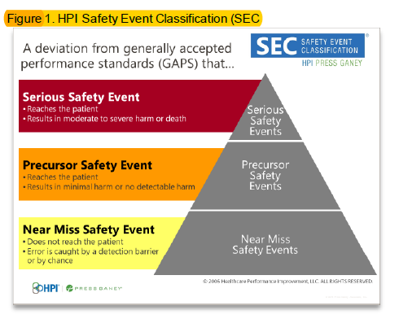
HPI Algorithm and Deviations from GAPS
GAPS – Generally Accepted Performance Standard

Slide 6
How it Works

Slide 7
Safety event classification DEFINITIONS
State Reportable Events (SRE): Can include SSEs, PSEs, Unsafe Conditions, and are required by the state of Utah to be reported. Patient Safety will triage these events.
Serious Safety Events (SSE): Reaches the patient and results in moderate to severe harm or death as a result of a deviation from Generally Accepted Performance Standards (GAPS)
Precursor Safety Events (PSE): Reaches the patient and results in minimal harm or no detectable harm as a result of deviations from GAPS
Near Miss Safety Event (NM): Does not reach the patient and the error is caught either by detection or chance
Not a safety event (NSE): No deviation in care. Care delivery went well according to generally accepted practice standards.
Unsafe Conditions: No event occurred, but a situation exists that has the potential to cause harm.

Slide 8
Current and Future Goals
Current
Falls
High risk medications
Future
Purposeful Provider Engagement
Triangulation of data
Improved reporting, follow-up and action planning

Slide 9
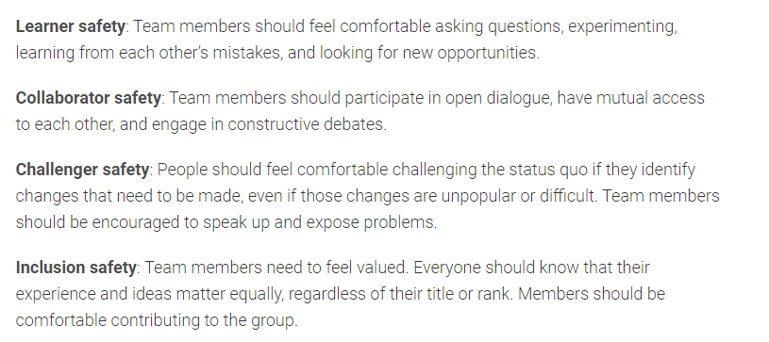
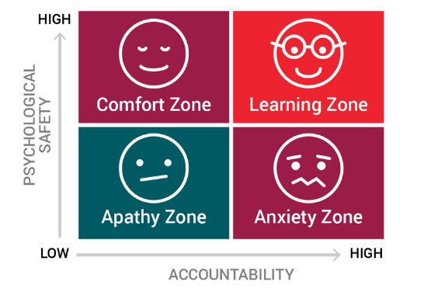
Psychological safety and your future
Psychological safety is about cultivating a work environment where people feel comfortable being and expressing themselves
SOURCE: https://accelerate.uofuhealth.utah.edu/improvement/psychological-safety-for-teams
Amy Edmonson, Building a psychologically safe workplace on you tube TED https://www.youtube.com/watch?v=LhoLuui9gX8
Notes:
Psychological safety–what is it?
D
uring the pandemic, we have thought a lot about the physical safety of our colleagues, staff, patients and selves. Do we have the right PPE, are we testing enough, how do we distribute the vaccine and encourage its use? It is equally, if not more, important to think about the psychological safety of those same team members and patients. Psychological safety is critical for our teams to function safely, learn from mistakes and innovate.
When Dr. Amy Edmondson was asked to examine medical errors through the lenses of team dynamics and communication, she hypothesized that teams that communicated better would make less errors. But when she looked at her data, she found that teams with higher communication ratings had more medical errors.
A closer assessment of these teams’ actions revealed surprising results. Although the teams that communicated better were indeed reporting their errors, the teams with worse communication ratings were actually making more medical errors but weren’t reporting them to the system.
The teams with better communication viewed mistakes as part of the learning process and used them as opportunities for improvement and innovation. For teams with poor communication, medical errors weren’t chances for growth—they were grounds for punishment or humiliation.
Based on her findings, Dr. Edmondson coined the term “psychological safety,” or the belief that one should not be ridiculed and punished for speaking up with ideas, questions, concerns or mistakes.
Psychological safety is about cultivating a work environment where people feel comfortable being and expressing themselves.
Combating the Common Knowledge Effect
When we work in a system where we’re under psychological danger or threat, we often allow fear to dictate our actions. We’re afraid of making mistakes, so we’re more apt to blame others when mistakes do happen. Instead of working in unison, team members are too scared to speak up and offer different ideas or opinions.
This leads to the common knowledge effect. When information that is held by the most people in a group has the strongest impact on the team’s decisions, that information will be propagated in order to maintain the status quo. If no one steps up to challenge that information and offer new insight, effective decision-making and innovation will grind to a halt.
In systems that encourage psychological safety, people feel comfortable admitting mistakes. Everyone is expected to share their mistakes, so that the team can learn and grow from that failure. Decisions inherently become more effective and creative.
Psychological safety is particularly crucial in health care environments, because we often find ourselves in situations where the outcome is not predetermined. When we must be flexible and adapt quickly, communicating honestly with our team becomes vital. If you’re operating within a system that disparages you for speaking up or questions your mental health when you make a mistake, you won’t feel safe enough to step forward.
Speaking out shouldn’t be a calculated risk—it should be inherent.
How do teams create psychological safety?
Facilitating psychological safety within a team takes a concerted effort. These four quadrants serve as the building blocks for creating a psychologically safe environment:
Psychologically safe team dynamics
Learner safety: Team members should feel comfortable asking questions, experimenting, learning from each other’s mistakes, and looking for new opportunities.
Collaborator safety: Team members should participate in open dialogue, have mutual access to each other, and engage in constructive debates.
Challenger safety: People should feel comfortable challenging the status quo if they identify changes that need to be made, even if those changes are unpopular or difficult. Team members should be encouraged to speak up and expose problems.
Inclusion safety: Team members need to feel valued. Everyone should know that their experience and ideas matter equally, regardless of their title or rank. Members should be comfortable contributing to the group.
Psychologically safe environment
Creating the ideal environment for growth and productivity requires a balance between psychological safety and accountability. The four zones of psychological safety—learning, comfort, apathy and anxiety—reflect shifts in that balance.
Learning zone: In a learning zone, team members experience high accountability and high psychological safety. This is the ideal learning environment for innovation and growth, because even though members are responsible for their actions, their team offers continuous support.
Comfort zone: Team members have high psychological safety and low accountability. While this zone is more relaxed, almost like a vacation, there is no push for creativity and growth.
Apathy zone: With low psychological safety and low accountability, team members fall into the apathy zone. There are no repercussions for mistakes, teams lack adequate communication and support, and individuals struggle to care about their work.
Anxiety zone: Team members experience low psychological safety and high accountability. Communication breaks down and when mistakes are made, people are often too scared of punishment or humiliation to take responsibility. Opportunities for learning and innovation are scarce.

Slide 10
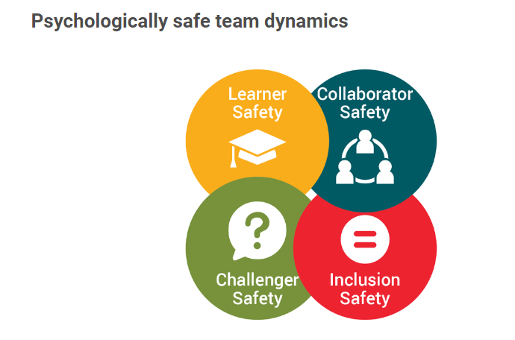
Fostering a psychologically safe environment leads to better learning opportunities, increased innovation, and improved patient safety.
https://accelerate.uofuhealth.utah.edu/improvement/psychological-safety-for-teams
https://www.youtube.com/watch?v=jbLjdFqrUNs

Slide 11
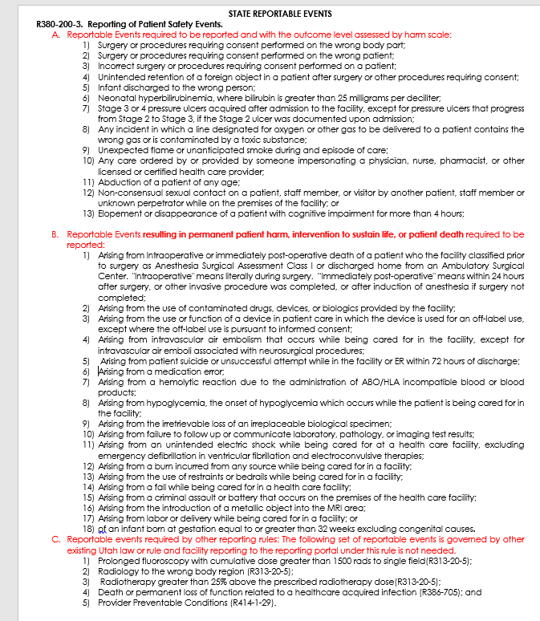
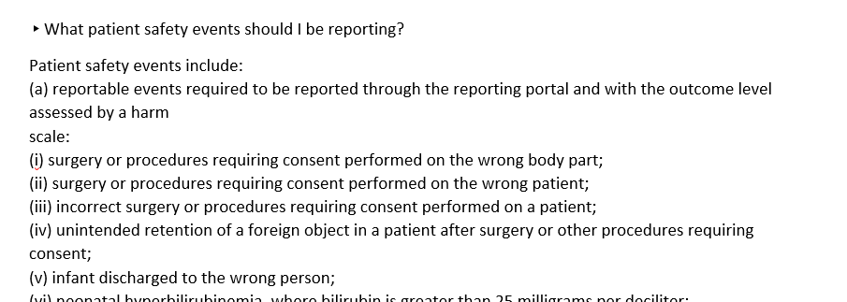
Interpreting the state rule
Improved Readability
https://patientsafety.health.utah.gov/faq/

Slide 12
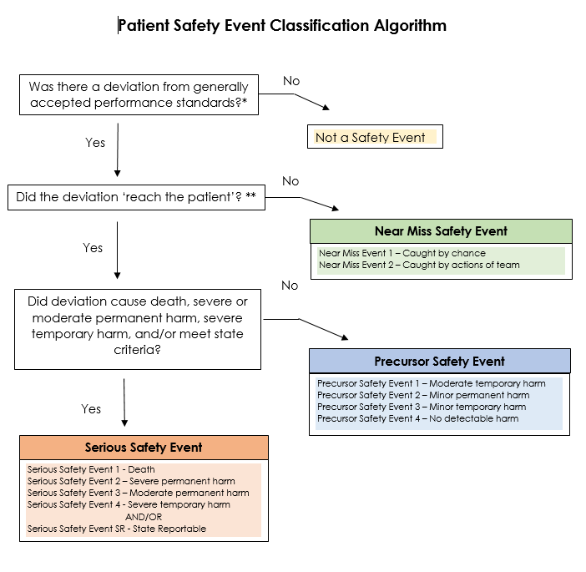
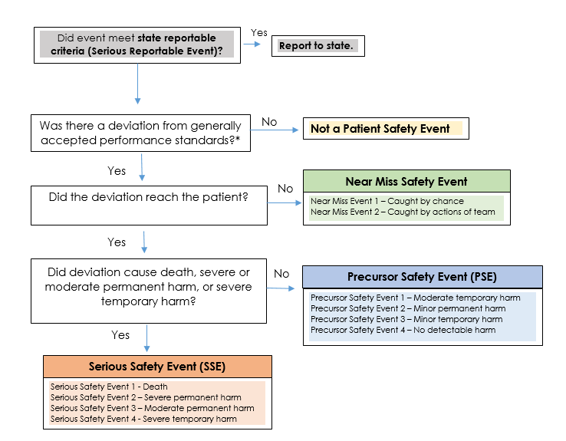
Application of the state rule
Notes:
Examples:
Regardless of harm: Risk of under reporting
Flame or smoke –generally does always reach patient
Wrong site/patient procedures ---
Resulting in harm (permanent, intervention to sustain life, death) – Risk of over reporting
Medication errors
Fall
Irretrievable loss of biologic specimen

Slide 13
Determining Major vs. Minor Surgery or Invasive Procedure
 | Major Surgery, Operative or Invasive Procedure | Minor Surgery, or Invasive Operative Procedure
Definition | More extensive resection Damage to the skin Cause damage to the tissues A high risk of infection | Small incisions are made Risk of infection is low Recovery time is shorter
Types of procedures/surgeries | Any abdominal or orthopedic surgery | Procedures requiring only skin excision or small sutures
Intervention | 1 or more of the following resulted: A body cavity was entered (liver biopsy, chest tubes) A mesenchymal barrier was crossed An organ was removed Normal anatomy was operatively altered Reduction of fracture Elbow radial head excision Extraction of third molars or >3 teeth Substantial impairment of physical or physiological functions is produced Joint replacements External Fixation Tendon Transfer Closure of Intestinal fistula I&D dental abscess Fracture dislocation Amputations | 1 or more of the following resulted: Manipulation of skin, mucous membranes, or superficial connective tissue as a result of: Dental care Nail extirpation Replacement of central venous access device Incision of periumbilical abscess Closure of fistula Debridement and pus drainage Burr holes Repeat Bio
Solimeno LP, Escobar MA, Krassova S, Seremetis S. Major and Minor Classifications for Surgery in People With Hemophilia: A Literature Review. Clin Appl Thromb Hemost. 2018;24(4):549-559. doi:10.1177/1076029617715117 https://www.ncbi.nlm.nih.gov/pmc/articles/PMC6714696/
Notes:
Helen

Slide 14
Our Work in Falls: Helen
Shifted from Falls Committee to Falls Friday
Now weekly instead of biweekly
More frontline representation with CNCs attending and presenting the falls that occurred on their units and lessons learned
In the process of auditing fall prevention strategies for best practices and standardization across acute care units
Found many units had great tools they were using but want to determine which are most effective and standardize across the system
Focusing on a teach back method and involving patients in their fall risk assessment to encourage understanding of their current mobility level and the importance of interventions being used in their care
Investigating unit flow, staffing assignments, and spatial optimization to help decrease response time to call lights and bed alarms
Notes:
Orange Star = Helen

Slide 15
Our work in Medication Errors: Raelynn
Large turnover in L&D
15 nurses left in a three month period
We saw cluster of Pitocin errors
Chart audit revealed a lapse in double signatures for Pitocin d/t no hard stop
Goal set to decrease Pitocin errors by improving dual signature compliance rate from baseline (Jan) 65% to 80% by September, 2022.
Hard stop put in EPIC for double signatures
Unit made a video on how the process should go (best practice)
Chart audits being done monthly
Notes:
Purple Star = Raelynn

Slide 16
Questions?

